Slide 1

On the Computing Power of Minecraft Redstone
A Lecture by Jaskin Kabir

Slide 2
A Refresher on Digital Logic
Binary Representation of Data and Logical Operations

Slide 3
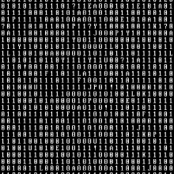
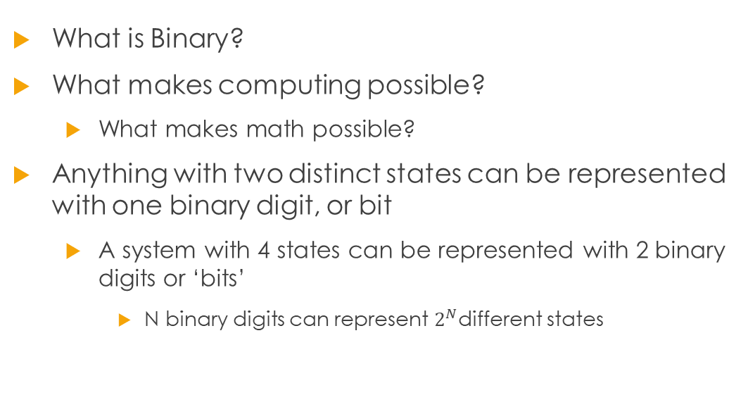
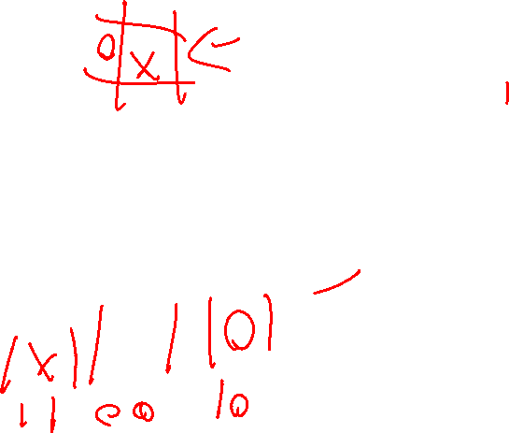
Binary Representation of Data
What is Binary?
What makes computing possible?
What makes math possible?
Anything with two distinct states can be represented with one binary digit, or bit
A system with 4 states can be represented with 2 binary digits or ‘bits’
N binary digits can represent $2^{N}$different states

Slide 4

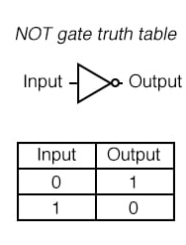
Binary Logic: NOT

Slide 5
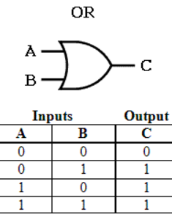
Binary Logic: OR

Slide 6
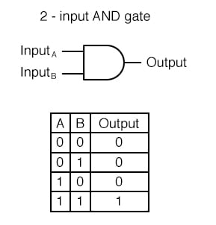
Binary Logic: AND

Slide 7
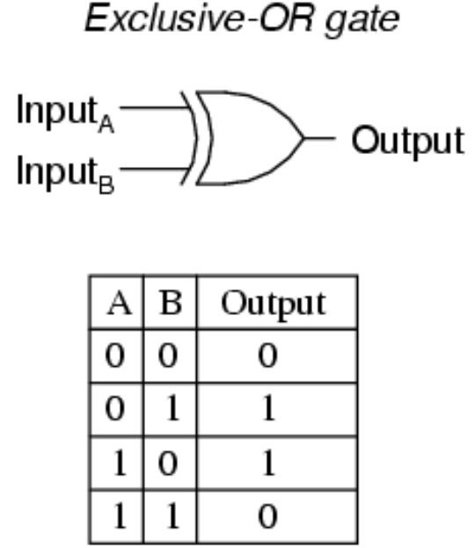
Binary Logic: XOR

Slide 8
Redstone Refresher
The basics of Redstone components

Slide 9
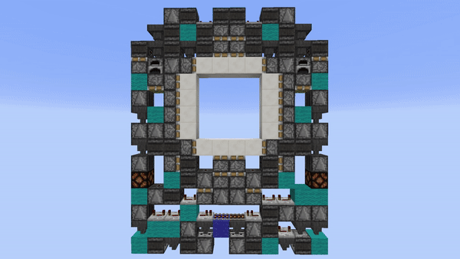
What is Redstone?
Minecraft’s simple ‘circuit simulator’
Wiring
Redstone dust laid on the ground carries an on or off signal
Also contains signal strength data
Can do pretty cool things
How about all things?

Slide 10
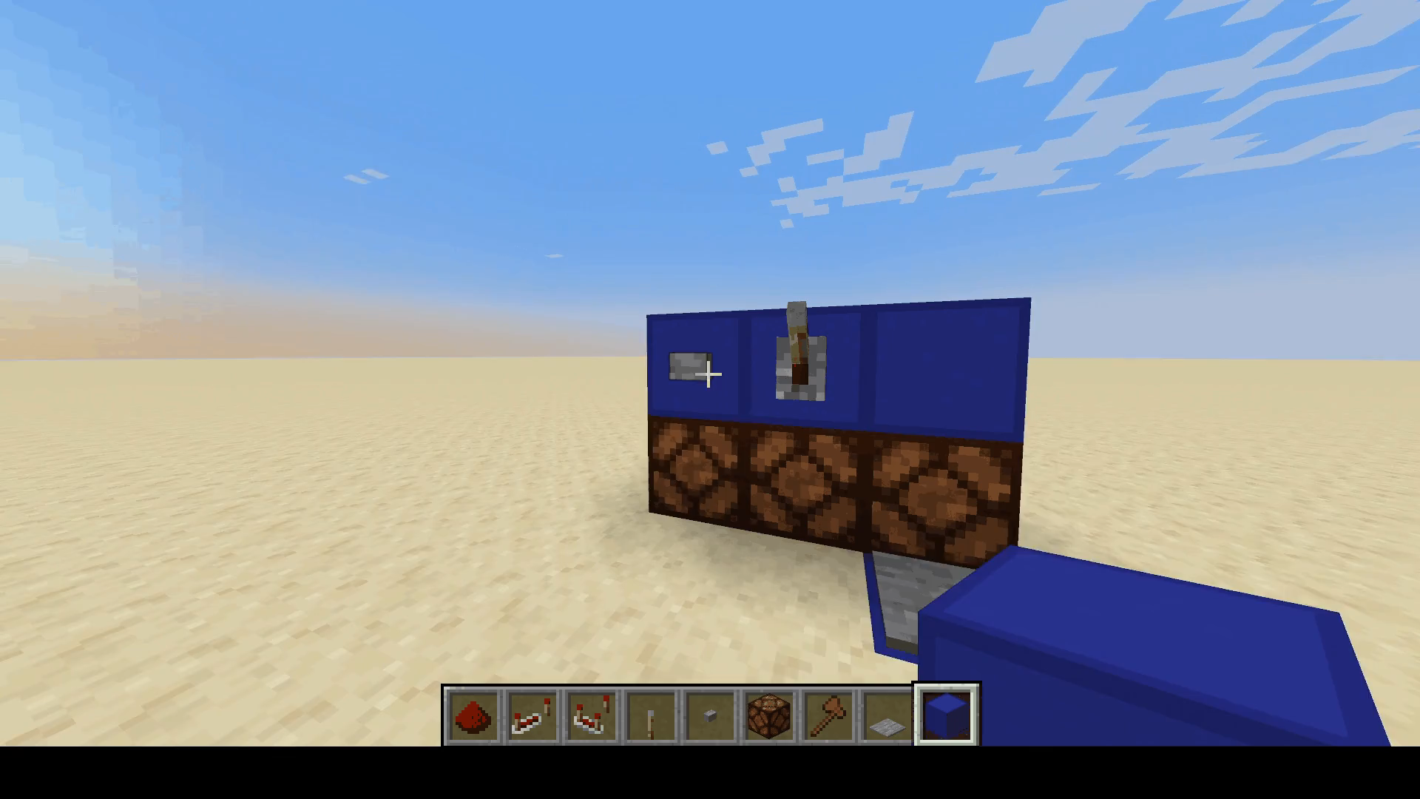

Inputs

Slide 11
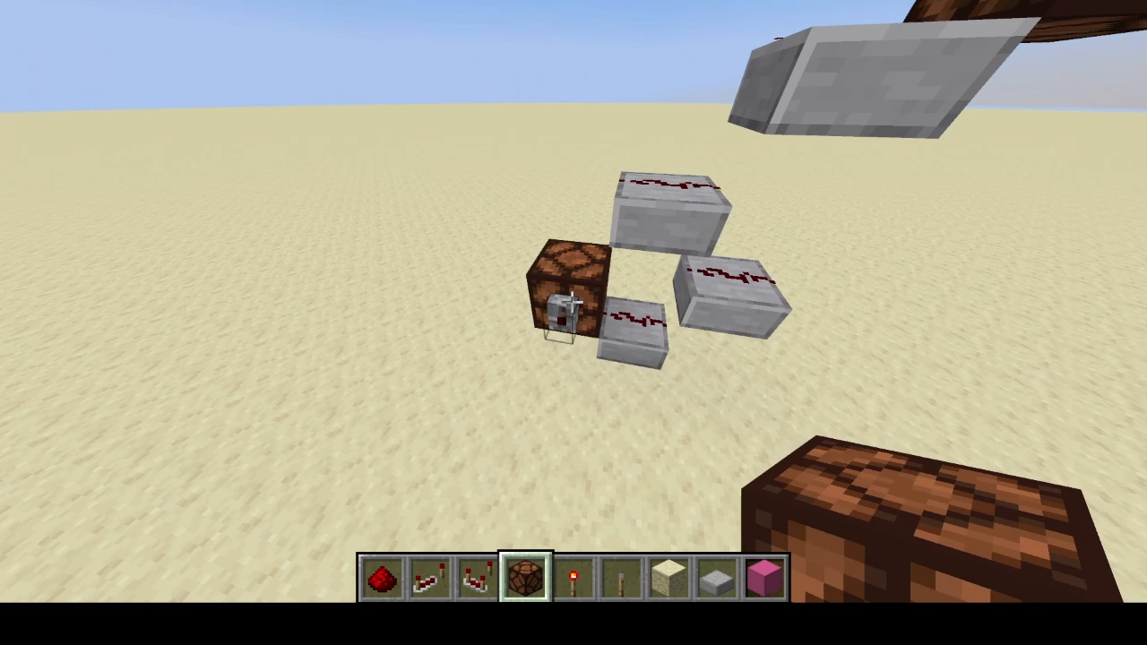
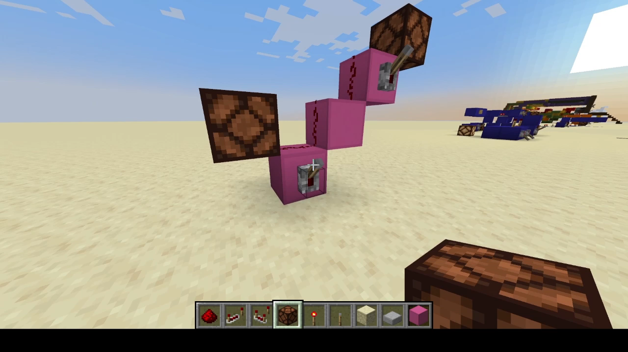
Wiring
A Redstone signal can be carried for 15 blocks
Why 15?
Redstone lines next to each other will interconnect
Plan wiring carefully
Moving a signal vertically
Staircase
Slab Tower

Slide 12
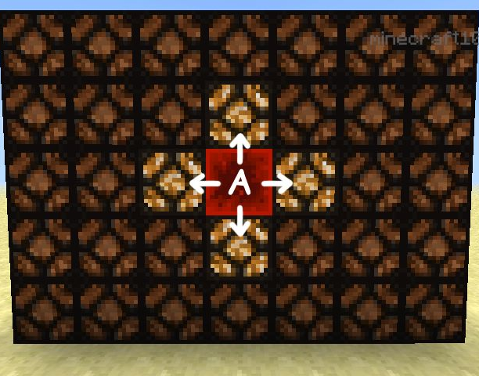
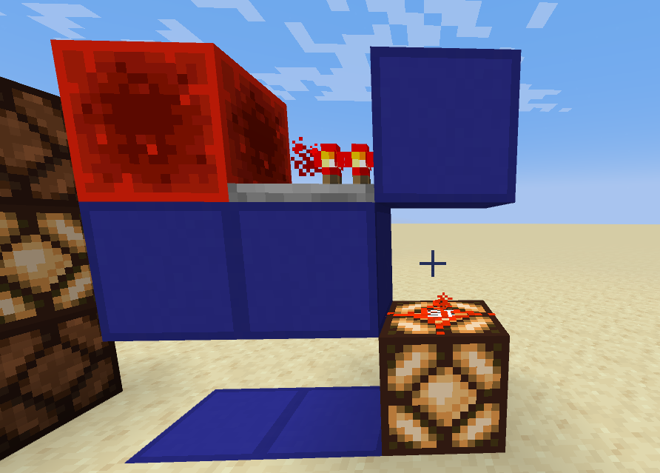
Power
If a block is strongly powered, it will power all adjacent blocks
Redstone wiring counts as a full block, even if it doesn’t look like one
A block can be weakly powered
It will not transfer its power to other blocks

Slide 13
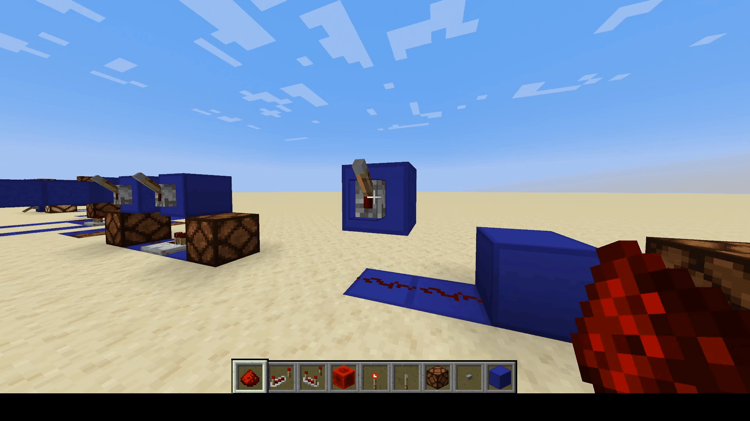
The Repeater: Strong Power

Slide 14
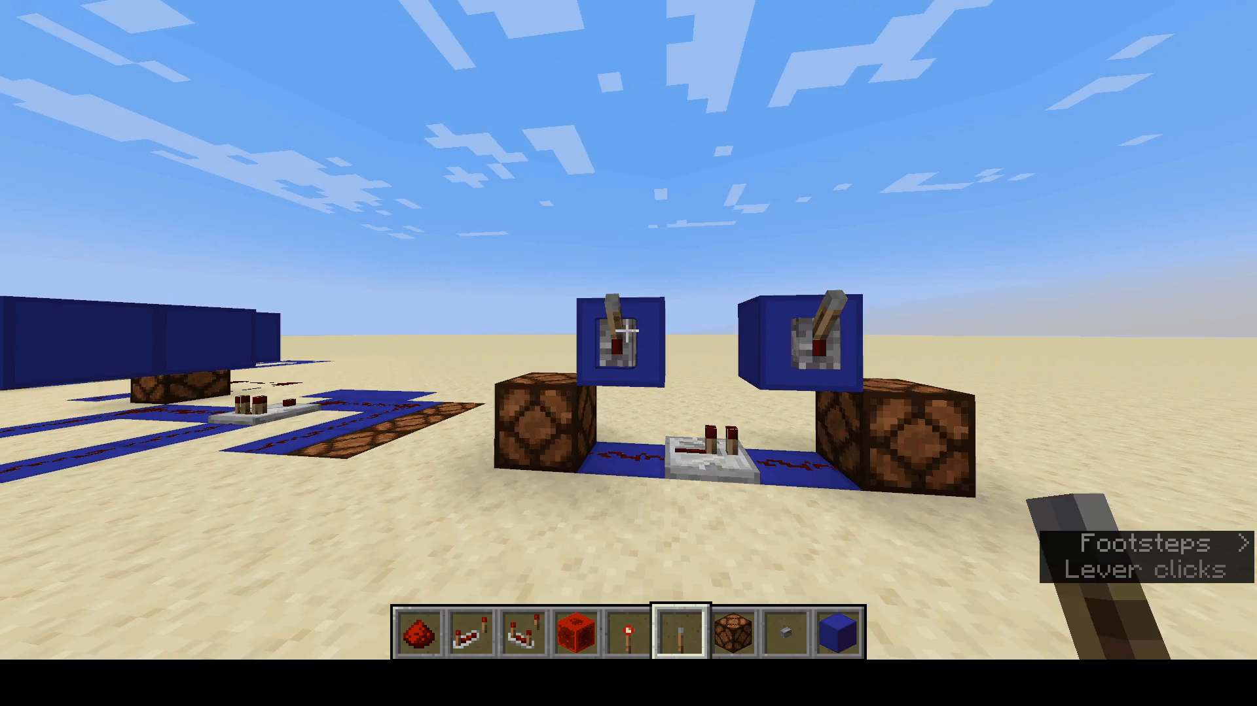
The Repeater: Directionality

Slide 15
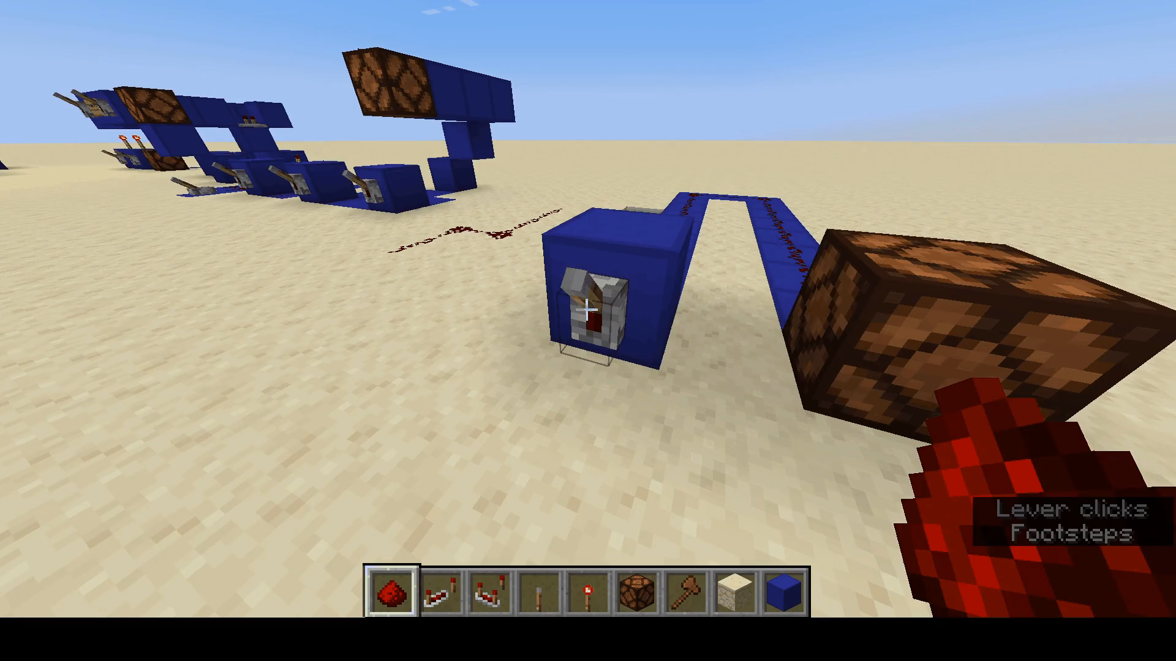
The Repeater: Repeating

Slide 16
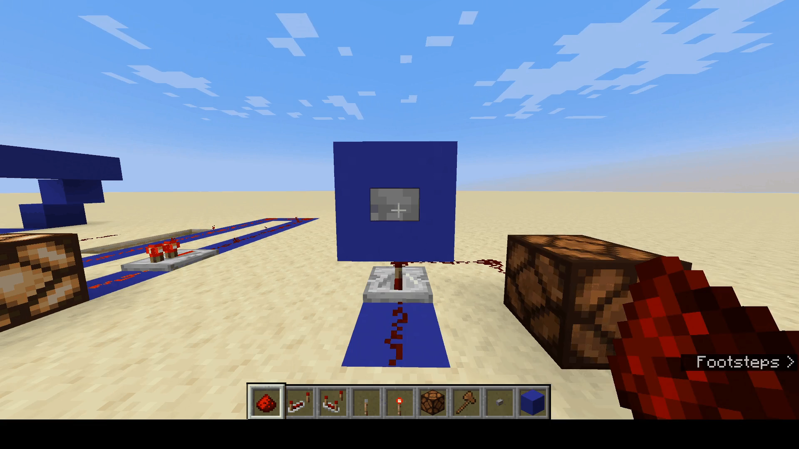
The Repeater: Delay

Slide 17
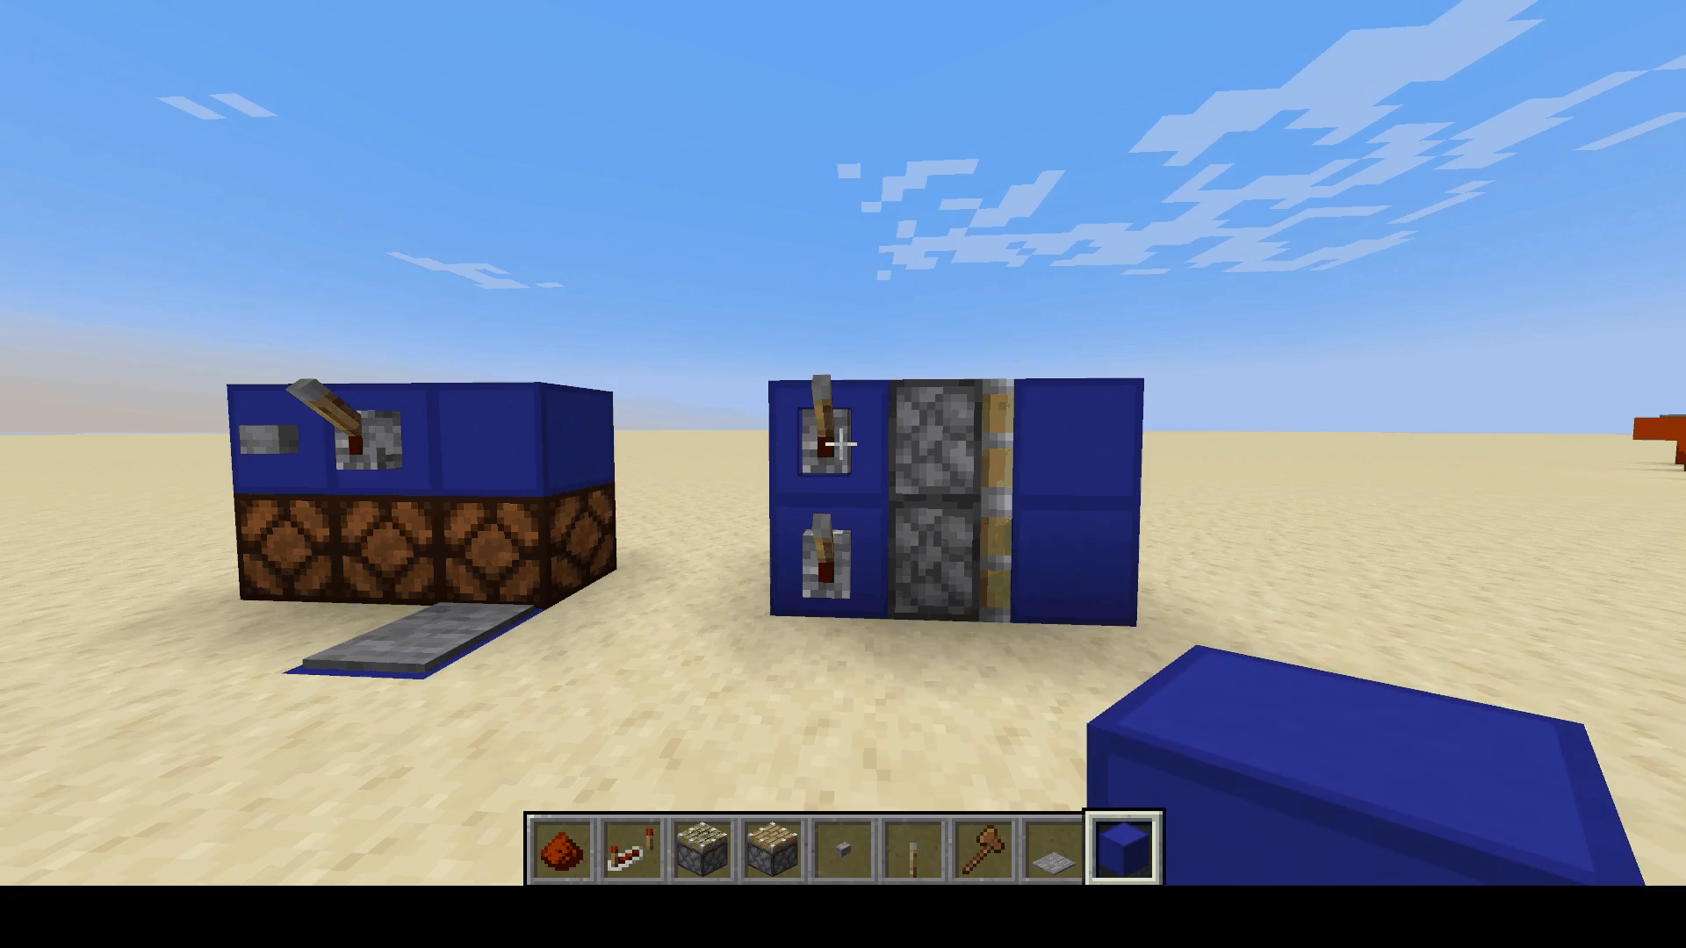
The Piston
Sticky and normal
One tick pulse

Slide 18
Minecraft’s Logical Building Blocks
Building logic gates in Minecraft

Slide 19
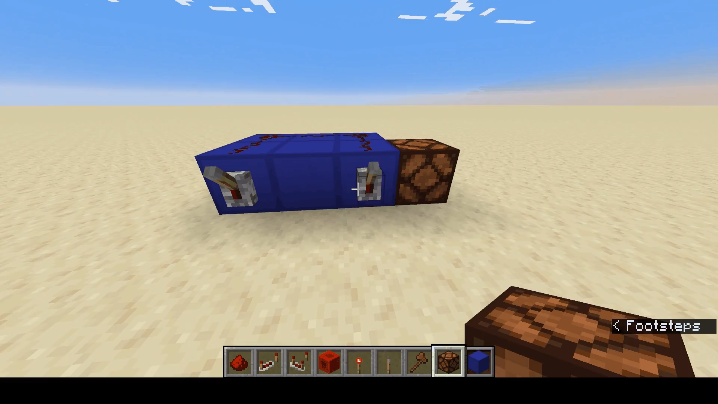
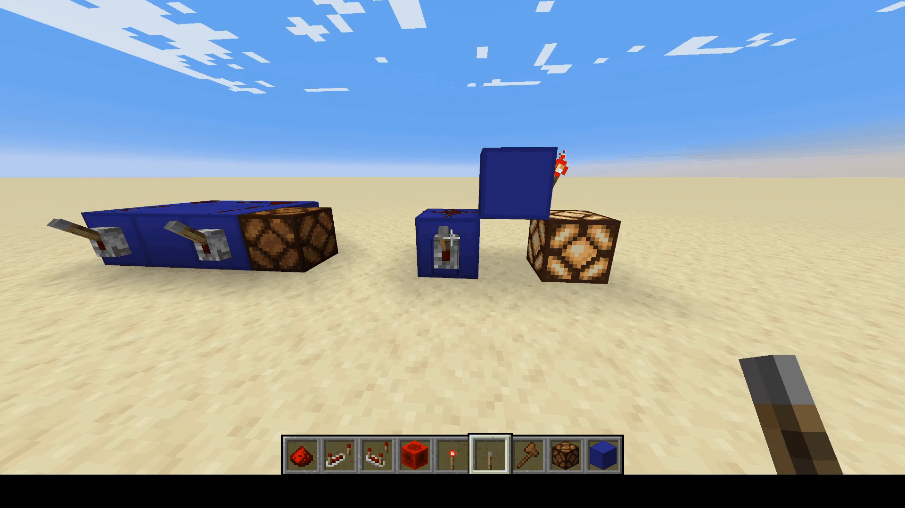
Minecraft’s Building Blocks
Only OR and NOT
From these two operations, all logical operations can be constructed. All computation can be achieved

Slide 20
Minecraft AND: Bubble Pushing
Can we make an AND gate with just OR and NOT?

Slide 21

MINECRAFT XOR: Comparators
Traditional $\overline{A}B+A\overline{B}$ method
Easier way using comparators
Very important gate

Slide 22
Storing Data in Minecraft
S/R Latches and T-Flip-Flops

Slide 23
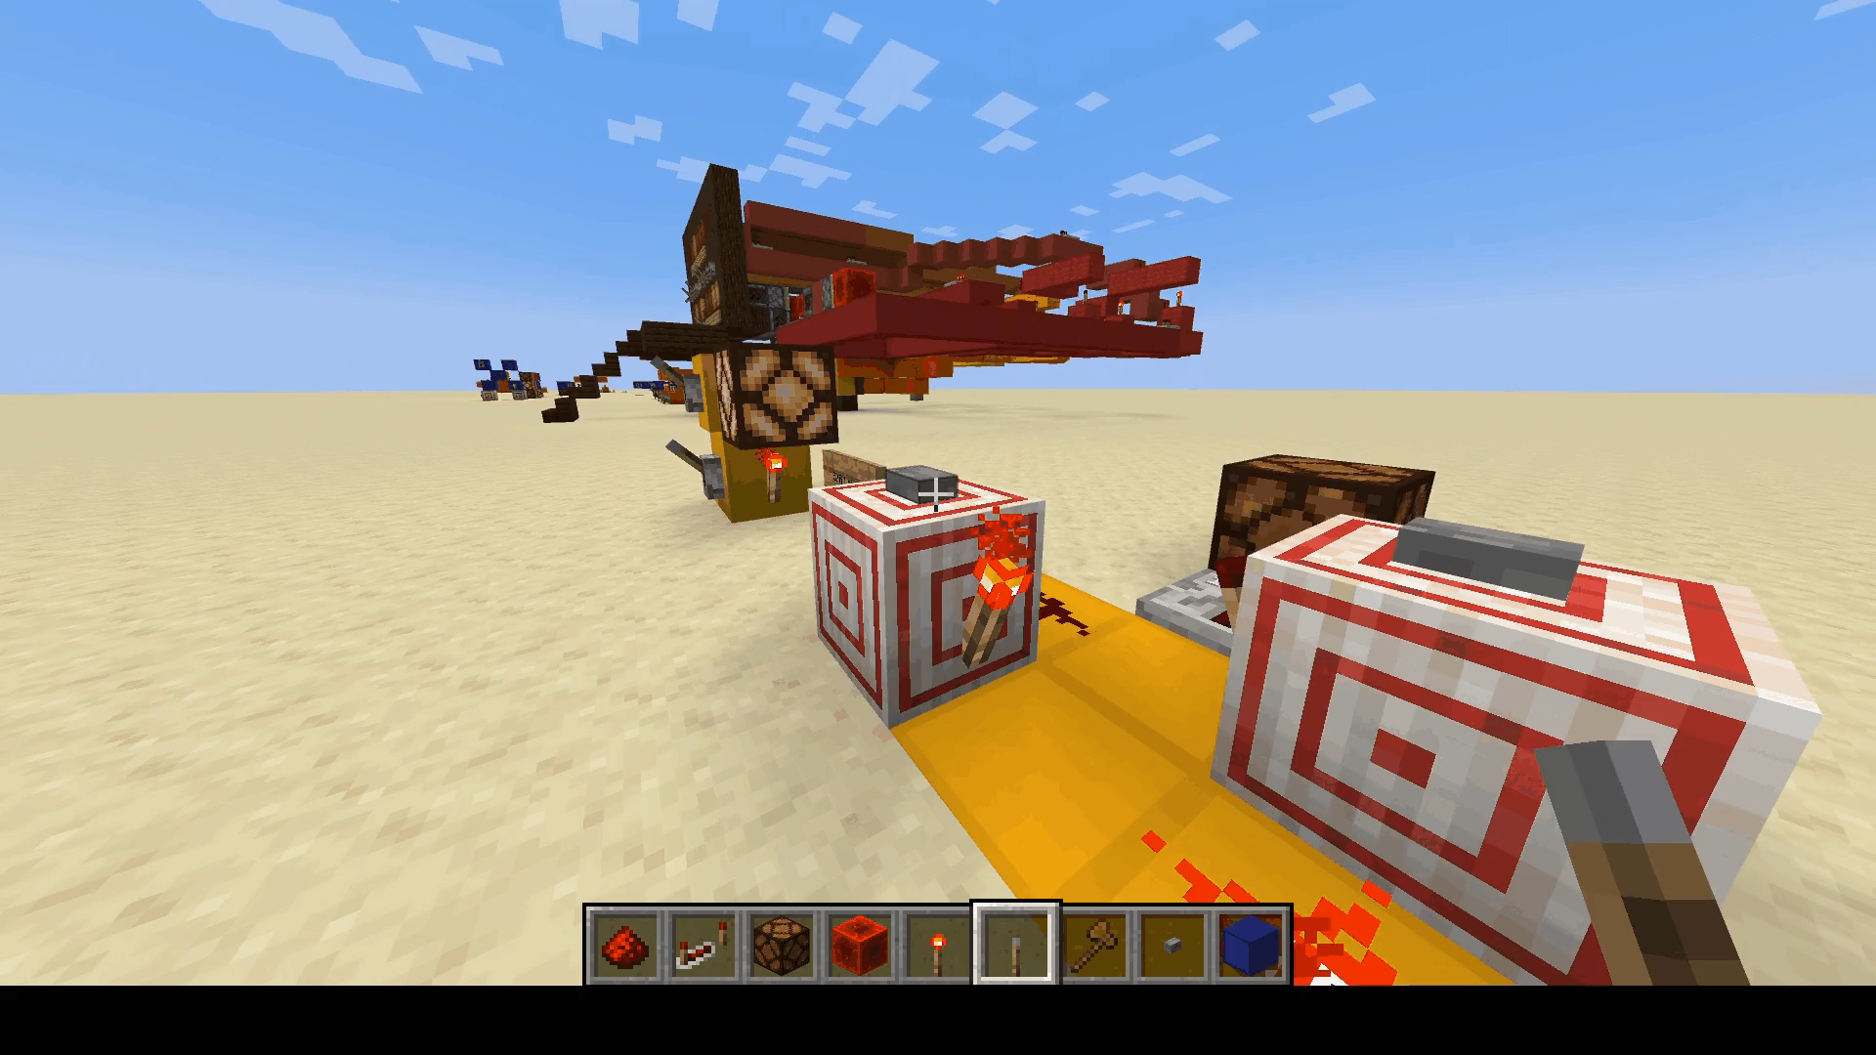
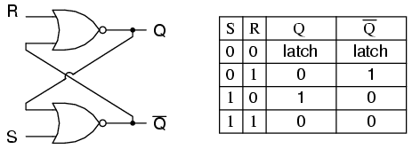
The S/R Latch
A memory Module that can be Set/Reset and latches its current state

Slide 24
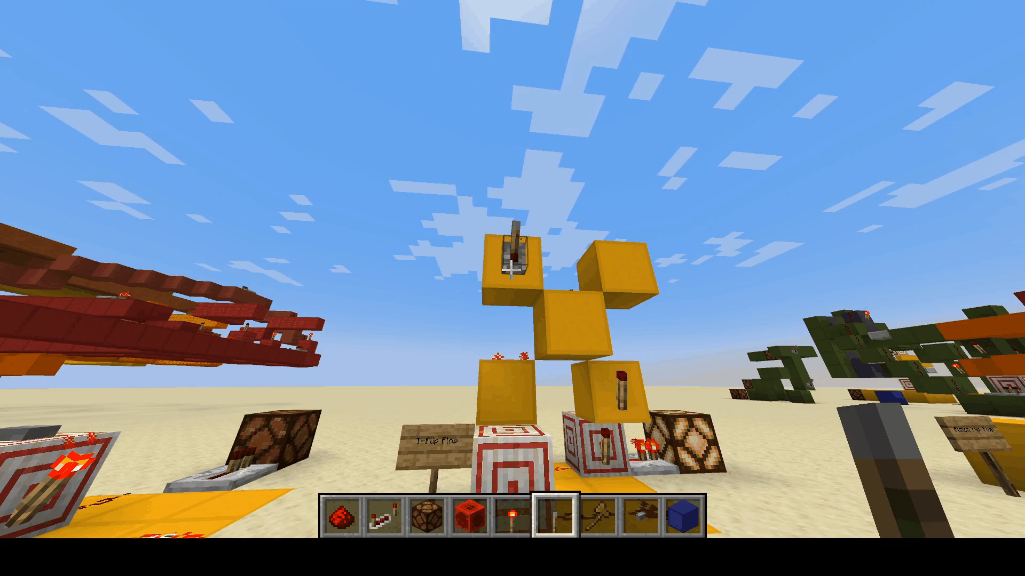
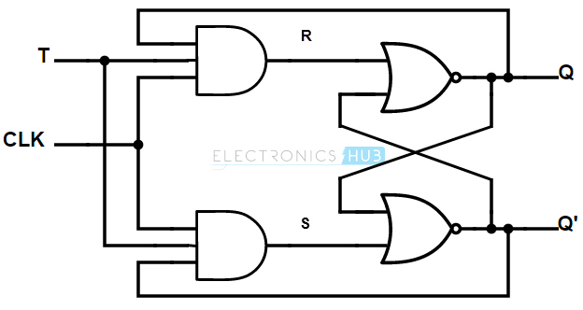
The T-Flip-Flop: Combinational Logic Method
A memory module that can be toggled on and off

Slide 25
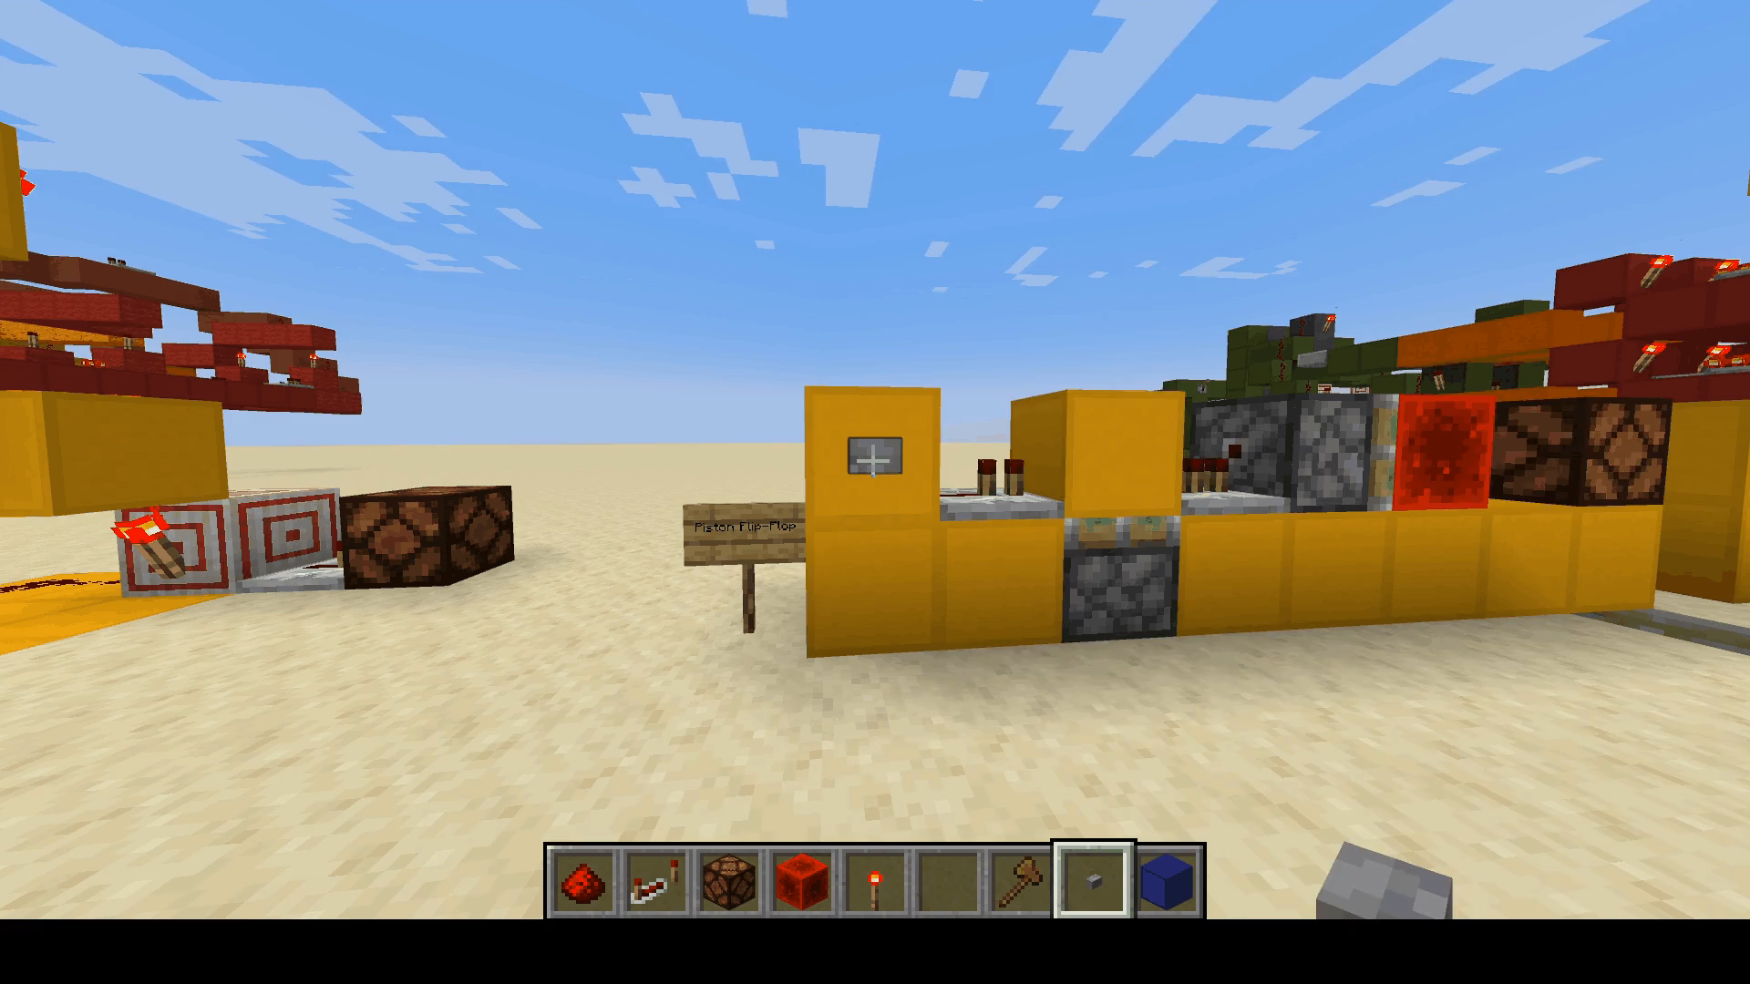
The T-Flip Flop: The Piston Method
A much simpler implementation unique to Minecraft
Utilizes the one-tick pulse

Slide 26
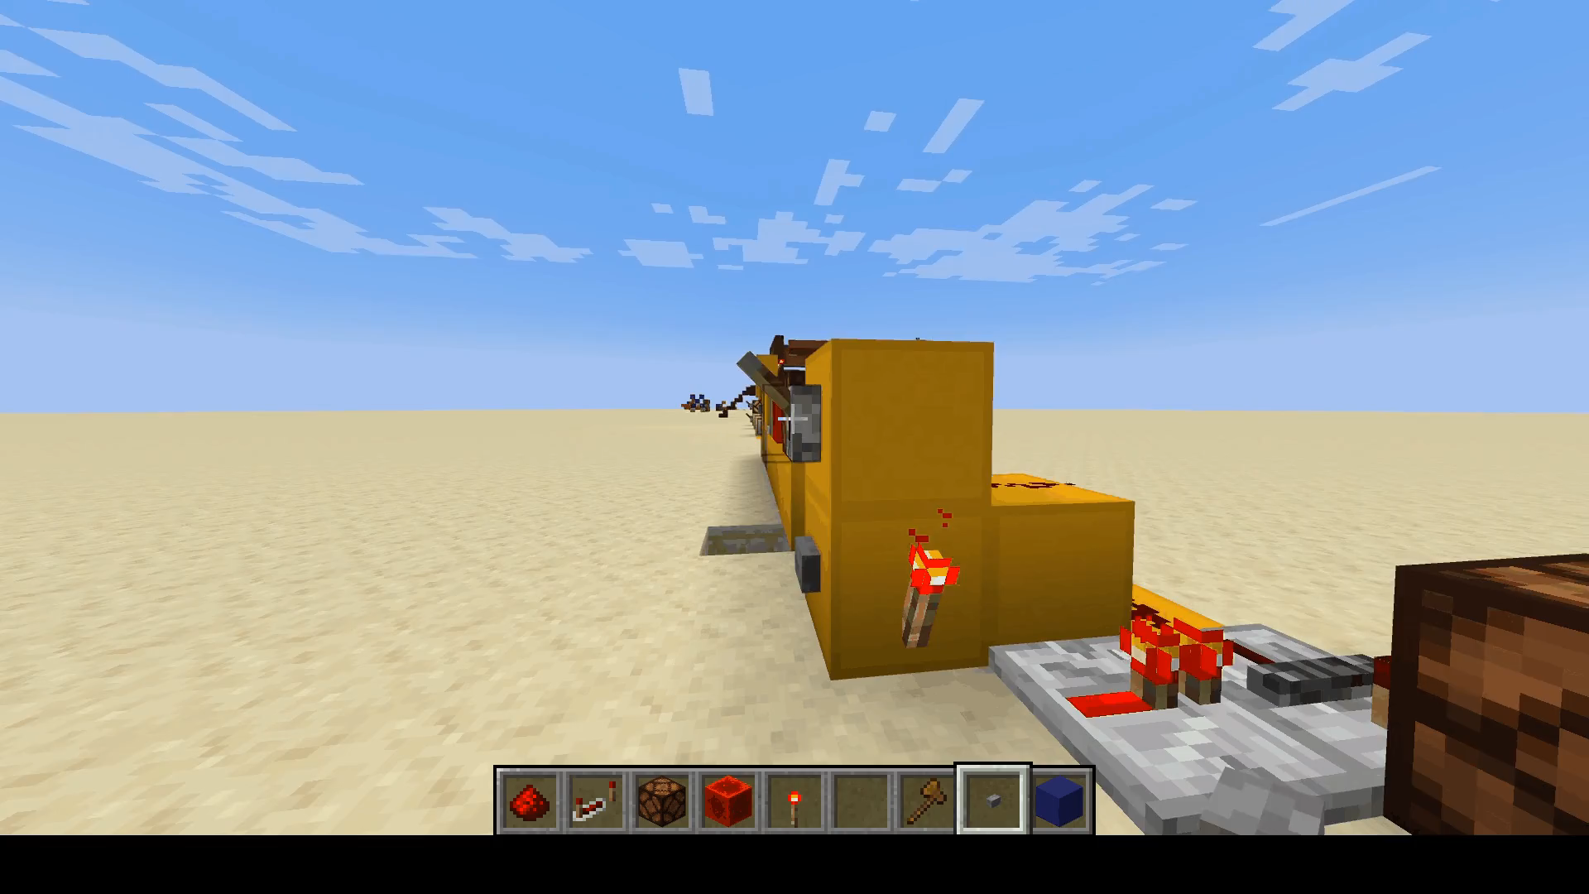
Repeater Locking: Memory Unique to Minecraft
A repeater can lock its state when it receives a repeater input to its side
Until the side repeater is depowered, the repeater will not respond to its input
Simple D-Flip-Flop

Slide 27
Tic Tac Toe: Designing a Complex Logic System
Design considerations, planning, and implementation

Slide 28
Planning Phase: Tips
Modularity
Design components first, then the overarching system
Add visual aids, split this up
Bugs and implementation issues cannot be planned for
Pros and Cons of hack vs methodical approach
Color Coding
DRAW
Preventing spaghetti

Slide 29
Planning Phase: Storing Data
What needs to be stored?
How can it be stored?
Encoding?
What logic needs to supplement the storage?
Overwrite protection?
Turn switching?

Slide 30
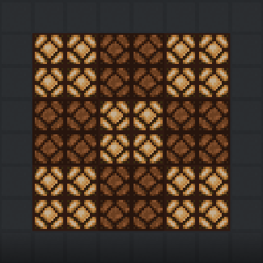
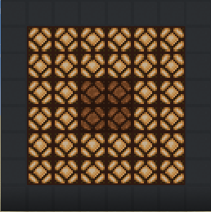
Planning Phase: Display
Display size
Shortcuts from encoding scheme
Shortcuts from display method

Slide 31
Planning Phase: Win/Tie Detection
How do you win in Tic Tac Toe?
Using encoding to our advantage

Slide 32
Planning Phase: Requirements
Storing data
# of bits
Add truth table?
State machine
Data encoding scheme
Practical considerations vs. first assumptions
Start from the high level and move down
Display first
Control Logic
Win/Tie detection
Turn switching
User input
Game end detection

Slide 33
Design Phase: Display
Binary decoding
Shortcuts from encoding scheme
DRAW
Add schematics

Slide 34
Design Phase: Win Detection
Required Logic
Modularity
Who won?

Slide 35
Design Phase: Tie Detection
Choosing the order of implementation
Leeching off win detectors
Tie vs. Win

Slide 36
Building Phase: Display
Redstone Lamp pixel display design
Encoding shortcuts

Slide 37
Building Phase: Memory
Different stacking methods
Trial and error
Edge detection
Turn Flip-Flop

Slide 38
Building Phase: Win/Tie/Game End Detection
Modularity

Slide 39
Building Phase: Wiring
COLOR CODE
DRAW
Sacrificing size for sustainability
Bus design
Trial and error
Failed designs

Slide 40
Final Thoughts
Solutions may be simpler than you think

